Slide 1
Session 16
Chapter 7 – Constraints, Keys and Foreign Keys
Database Systems

Slide 2
Objectives
1
Understand what are data integrity
2
Understand what are foreign keys
3
Know how to use SQL to create constraints of a relation
4
Know how to use SQL to modify constraints of a relation
5
Understand what are Data integrity

Slide 3
Contents
1
Constraints
2
Data integrity

Slide 4
1. Constraints
A constraint is a mechanism that may be used to limit the values entered into a column.
CONSTRAINTS
NULL
CHECK
FOREIGN
PRIMARY
Attribute-based check
Tube-based check
Assertions

Slide 5
1.1. NULL constraints
The NULL constraint determines whether or not data has to be entered into a column.
A NULL value in relational theory indicates that an attribute has an unknown value, generally thought of as a maybe. It is important to understand that when two NULL values are compared, they are never equal.

Slide 6
1.2. CHECK constraints
This allows us to define an allowable range of values for a column.
For example, we can create a constraint on a column that stores the month of the year which only allows a value of 1 through 12.

Slide 7
1.2.1. Attribute-Based Checks
Constraints on the value of a particular attribute.
Add CHECK(<condition>) to the declaration for the attribute.
The condition may use the name of the attribute, but any other relation or attribute name must be in a subquery.

Slide 8
Example: Attribute-Based Check
CREATE TABLE Sells (
bar CHAR(20),
beer CHAR(20),
price REAL [constraint ck_sells_price] CHECK ( price <= 5.00 )
);
OR
ALTER TABLE Sells
ADD [constraint ck_sells_price] CHECK ( price <= 5.00 );

Slide 9
Timing of Checks
Attribute-based checks are performed when creating the constraint and when a value for that attribute is inserted or updated.
  Example: CHECK (price <= 5.00) checks every new price and rejects the modification (for that tuple) if the price is more than $5.

Slide 10
1.2.2. Tuple-Based Checks
CHECK (<condition>) may be added as a relation-schema element.
The condition may refer to any attribute of the relation.
  But other attributes or relations require a subquery.
Checked on insert or update only.

Slide 11
Example: Tuple-Based Check
Only Joe’s Bar can sell beer for more than $5:
CREATE TABLE Sells (
bar CHAR(20),
beer CHAR(20),
price REAL,
[constraint ck_sells_price] CHECK (bar = ’Joe’’s Bar’ OR price <= 5.00)
);
OR
ALTER TABLE Sells
ADD constraint ck_sells_price CHECK (bar = ’Joe’’s Bar’ OR price <= 5.00);

Slide 12
1.2.3. Assertions
These are database-schema elements, like relations or views.
Defined by:
CREATE ASSERTION <name>
CHECK (<condition>);
Condition may refer to any relation or attribute in the database schema.
Note: SQL SERVER does not provide CREATE ASSERTION statement.

Slide 13
Example: Assertion
In Sells(bar, beer, price), no bar may charge an average of more than $5.
CREATE ASSERTION NoRipoffBars CHECK (
NOT EXISTS (
SELECT bar FROM Sells
GROUP BY bar
HAVING 5.00 < AVG(price)
));
Bars with an
average price
above $5

Slide 14
Example: Assertion
In Drinkers(name, addr, phone) and Bars(name, addr, license), there cannot be more bars than drinkers.
CREATE ASSERTION FewBar CHECK (
(SELECT COUNT(*) FROM Bars) <=
(SELECT COUNT(*) FROM Drinkers)
);

Slide 15
Timing of Assertion Checks
In principle, we must check every assertion after every modification to any relation of the database.
A clever system can observe that only certain changes could cause a given assertion to be violated.
  Example: No change to Beers can affect FewBar. Neither can an insertion to Drinkers.

Slide 16
1.3. Foreign Key constraint
Are used to make certain that a value in one table matches the key of a different table. They are used both to ensure data integrity and to maintain relationships between tables.

Slide 17
Example: Foreign Key
CREATE TABLE Beers (
name CHAR(20) PRIMARY KEY,
manf CHAR(20) );
CREATE TABLE Sells (
bar CHAR(20),
beer CHAR(20),
price REAL,
[constraint fk_sells_beers] FOREIGN KEY(beer) REFERENCES Beers(name));
OR
ALTER TABLE Sells
ADD [constraint fk_sells_beers] FOREIGN KEY(beer) REFERENCES Beers(name);

Slide 18
Foreign Keys: Maintaining Referential Integrity
If there is a foreign-key constraint from relation R to relation S, two violations are possible:
  An insert or update to R introduces values not found in S.
  A deletion or update to S causes some tuples of R to “dangle.”

Slide 19
Foreign Keys: Maintaining Referential Integrity
The Default policy: Reject violating modifications (default option of SQL).
The Cascade policy: changes to the references attributes are mimicked at the foreign key. For example:
  When a beer is deleted, we delete also Sells tuple corresponding to the deleted beer.
  When a beer is updated, we change also the value of this beer in Sells tuples.
The Set NULL policy: the foreign-key value is changed to NULL when there is a modification to the referenced relation. For example, change the beer in Sells tuples to NULL.

Slide 20
Foreign Keys: Enforcing FK
Example: suppose R = Sells, S = Beers.
An insert or update to Sells that introduces a nonexistent beer must be rejected.
A deletion or update to Beers that removes a beer value found in some tuples of Sells can be handled in three ways (next slide).

Slide 21
Foreign Keys: Choosing a Policy
When we declare a foreign key, we may choose policies SET NULL or CASCADE independently for deletions and updates.
Follow the foreign-key declaration by:
  ON [UPDATE, DELETE]
  [SET NULL CASCADE]
Two such clauses may be used.
Otherwise, the default (reject) is used.

Slide 22
Example: Setting Policy
CREATE TABLE Sells (
bar CHAR(20),
beer CHAR(20),
price REAL,
[constraint fk_sells_beers] FOREIGN KEY(beer)
REFERENCES Beers(name)
ON DELETE SET NULL
ON UPDATE CASCADE
);
OR
ALTER TABLE Sells
ADD [constraint fk_sells_beers] FOREIGN KEY(beer)
REFERENCES Beers(name)
ON DELETE SET NULL
ON UPDATE CASCADE;

Slide 23
1.4. Keys Definition
K is a key for relation R if:
1. K → all attributes of R. (Uniqueness)
2. For no proper subset of K is (1) true. (Minimality)
If K at least satisfies (1), then K is a superkey.

Slide 24
Example
Lastname Firstname Student ID Major
Key Key
(2 attributes)
Superkey
Note: There are alternate keys
Keys are {Lastname, Firstname} and {StudentID}

Slide 25
Single-Attribute Keys
Place PRIMARY KEY or UNIQUE after the type in the declaration of the attribute.
Example:
CREATE TABLE Beers (
name CHAR(20)[constraint uq_beers_name] UNIQUE,
manf CHAR(20)
);
OR
ALTER TABLE Beers
ADD [constraint uq_beers_name] UNIQUE (name);

Slide 26
Multi-attribute Key
The bar and beer together are the key for Sells:
CREATE TABLE Sells (
bar CHAR(20),
beer VARCHAR(20),
price REAL,
[constraint pk_Sell_bar_beer] PRIMARY KEY (bar, beer)
);
OR
ALTER TABLE Sells
ADD [constraint pk_Sell_bar_beer] PRIMARY KEY (bar, beer);

Slide 27
Drop constraints
Drop existing constraint:
ALTER TABLE [table_name]
DROP CONSTRAINT [constraint_name]
Example:
ALTER TABLE Sells
DROP CONSTRAINT pk_Sell_bar_beer

Slide 28
2. Data integrity
Data integrity is the assurance that data is Consistent and Correct
Data integrity is normally enforced in a Database System by a series of integrity constraints or rules
Three types of integrity constraints are: entity integrity, referential integrity and domain integrity

Slide 29
2.1. Entity integrity
Entity integrity concerns the concept of a Primary Key. Entity integrity is an integrity rule which states that every table must have a primary key and that the column or columns chosen to be the primary key should be unique and not null.

Slide 30
2.2. Referential integrity
Referential integrity concerns the concept of a Foreign Key.
The referential integrity rule states that any foreign key value can only be in one of two states:
  The usual state is that the foreign key value refers to a primary key value of some table in the database.
  Occasionally, and this will depend on the rules of the business, a foreign key value can be null. In this case we are explicitly saying that either there is no relationship between the objects represented in the database or that this relationship is unknown.

Slide 31
2.3. Domain integrity
Domain integrity specifies that all columns in relational database must be declared upon a defined domain.
The primary unit of data in the relational data model is the data item. Such data items are said to be non-decomposable or atomic. A domain is a set of values of the same type. Domains are therefore pools of values from which actual values appearing in the columns of a table are drawn

Slide 32
Thank You !

Slide 33

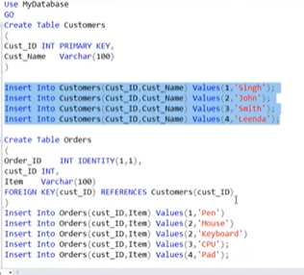

Slide 34
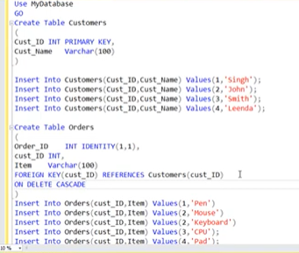

Slide 35
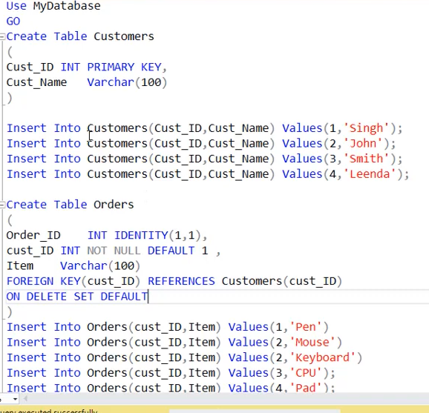

Slide 36
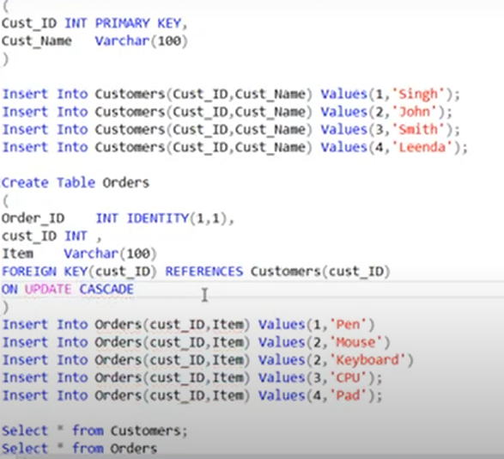

Slide 37
